Slide 1
Unit-II
Equilibrium diagram and Iron -Iron Carbide Diagram

Slide 2
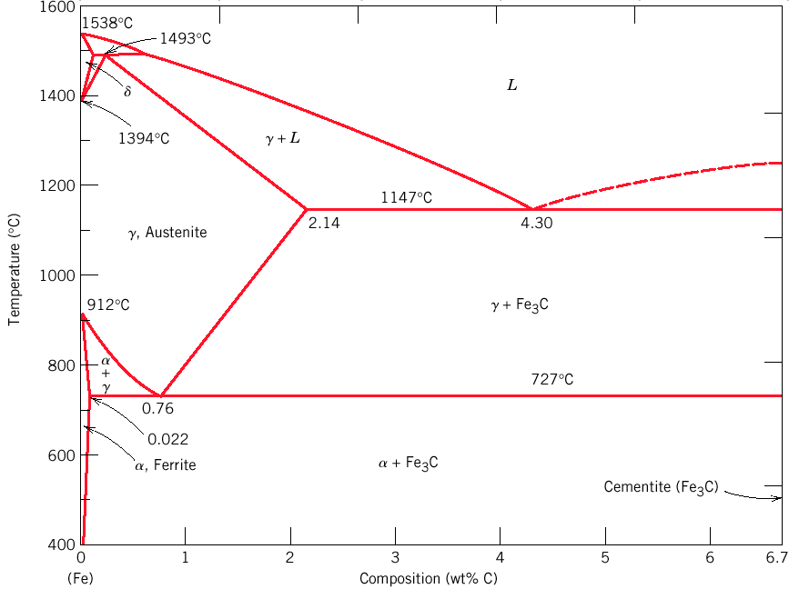
Iron Iron Carbide Diagram

Slide 3
Various phases that appear on the Iron-Carbon equilibrium phase diagram
Austenite
Ferrite
Pearlite
Cementite
Martensite*
Ledeburite

Slide 4
δ ferrite
BCC structure
Paramagnetic
α ferrite
BCC structure
Ferromagnetic
Fairly ductile

Slide 5
γ austenite
FCC structure
Non-magnetic
Ductile
Fe₃C cementite
Orthorhombic
Hard
brittle

Slide 6
Various Features of Fe-C diagram
Phases present
L
α ferrite
BCC structure
Ferromagnetic
Fairly ductile
δ
BCC structure
Paramagnetic
γ austenite
FCC structure
Non-magnetic
ductile
Fe₃C cementite
Orthorhombic
Hard
brittle
Reactions
Peritectic L + δ = γ
Max. solubility of C in ferrite=0.022%
Max. solubility of C in austenite=2.11%
Eutectic L = γ + Fe₃C
Eutectoid γ = α + Fe₃C

Slide 7
Phases in Fe–Fe₃C Phase Diagram
α-ferrite - solid solution of C in BCC Fe
Stable form of iron at room temperature.
The maximum solubility of C is 0.022 wt%
Transforms to FCC γ-austenite at 912 °C
γ-austenite - solid solution of C in FCC Fe
The maximum solubility of C is 2.14 wt %.
Transforms to BCC δ-ferrite at 1395 °C
Is not stable below the eutectic temperature (727 ° C) unless cooled rapidly (Chapter 10)
δ-ferrite solid solution of C in BCC Fe
The same structure as α-ferrite
Stable only at high T, above 1394 °C
Melts at 1538 °C
Fe₃C (iron carbide or cementite)
This intermetallic compound is metastable, it remains as a compound indefinitely at room T, but decomposes (very slowly, within several years) into α-Fe and C (graphite) at 650 - 700 °C
Fe-C liquid solution

Slide 8
C is an interstitial impurity in Fe. It forms a solid solution with α, γ, δ phases of iron
Maximum solubility in BCC α-ferrite is 0.022 wt% at727 °C. BCC:relatively small interstitial positions
Maximum solubility in FCC austenite is 2.14 wt% at 1147 °C - FCC has larger interstitial positions
Mechanical properties: Cementite (Fe₃C is hard and brittle: strengthens steels. Mechanical properties also depend on microstructure: how ferrite and cementite are mixed.
Magnetic properties: α -ferrite is magnetic below 768 °C, austenite is non-magnetic
Classification. Three types of ferrous alloys:
Pure Iron: < 0.008 wt % C in α−ferrite at room T
Steels: up to 2.14 wt % C (usually < 1 wt % ) α-ferrite + Fe₃C at room T (Chapter 12)
Cast iron: 2.14 - 6.7 wt % (usually < 4.5 wt %)

Slide 9
Invariant Reactions
Peritectic, at 1490 deg.C, with low wt% C alloys (almost no engineering importance).
Eutectoid, at 723 deg.C with eutectoid composition of 0.8wt% C, two-phase mixture (ferrite & cementite). They are steels.
Eutectic, at 1130 deg.C, with 4.3wt% C, alloys called cast irons.

Slide 10
Peritectic L + δ= γ
Eutectic L = γ + Fe₃C
Eutectoid γ = α + Fe₃C
The diagram shows three horizontal lines which indicate isothermal reactions (on cooling / heating):
First horizontal line is at 1490°C, where peritectic reaction takes place:
Liquid + δ ↔ austenite
Second horizontal line is at 1130°C, where eutectic reaction takes place:
liquid ↔ austenite + cementite
Third horizontal line is at 723°C, where eutectoid reaction takes place:
austenite ↔ pearlite (mixture of ferrite & cementite)

Slide 11
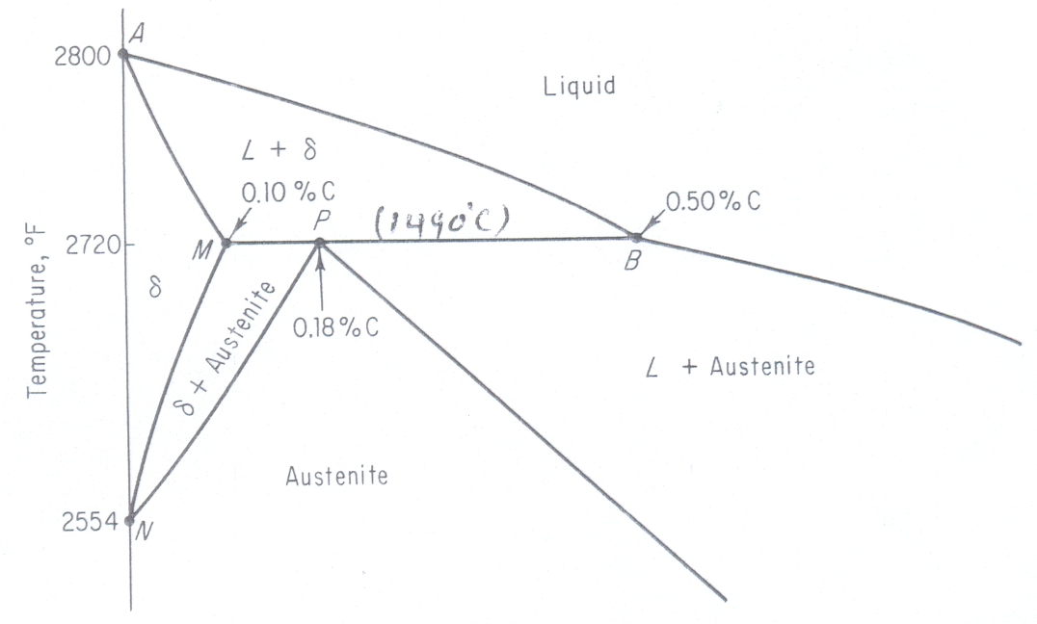
Peritectic, at 1490 deg.C, with low wt% C alloys

Slide 12
Eutectic and Eutectoid reactions in Fe–Fe₃C
Eutectic: 4.30 wt% C, 1147 °C
L ↔ γ + Fe₃C
Eutectoid: 0.76 wt%C, 727 °C
γ(0.76 wt% C) ↔ α (0.022 wt% C) + Fe₃C
Eutectic and Eutectoid reactions are important in heat treatment of steels

Slide 13
Eutectic and Eutectoid reactions in Fe–Fe₃C
Eutectic: 4.30 wt% C, 1147 °C
L ↔ γ + Fe₃C
Eutectoid: 0.76 wt%C, 727 °C
γ(0.76 wt% C) ↔ α (0.022 wt% C) + Fe₃C
Eutectic and Eutectoid reactions are important in heat treatment of steels

